Slide 1
CITY PARK PROJECT

Slide 2
Current Issues
CONGESTION
SAFETY
CONVIENCE
ANALYTICS

Slide 3
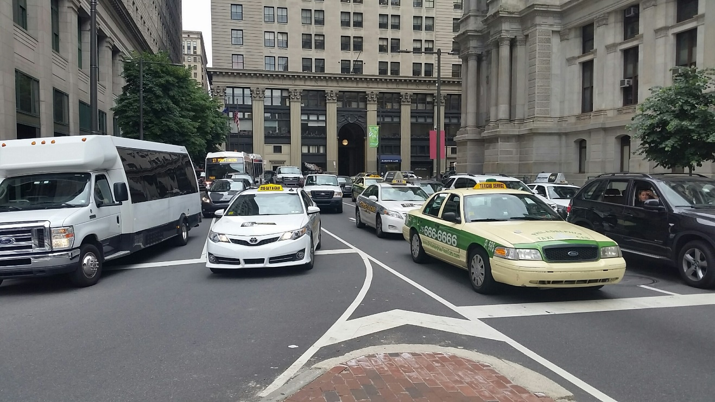
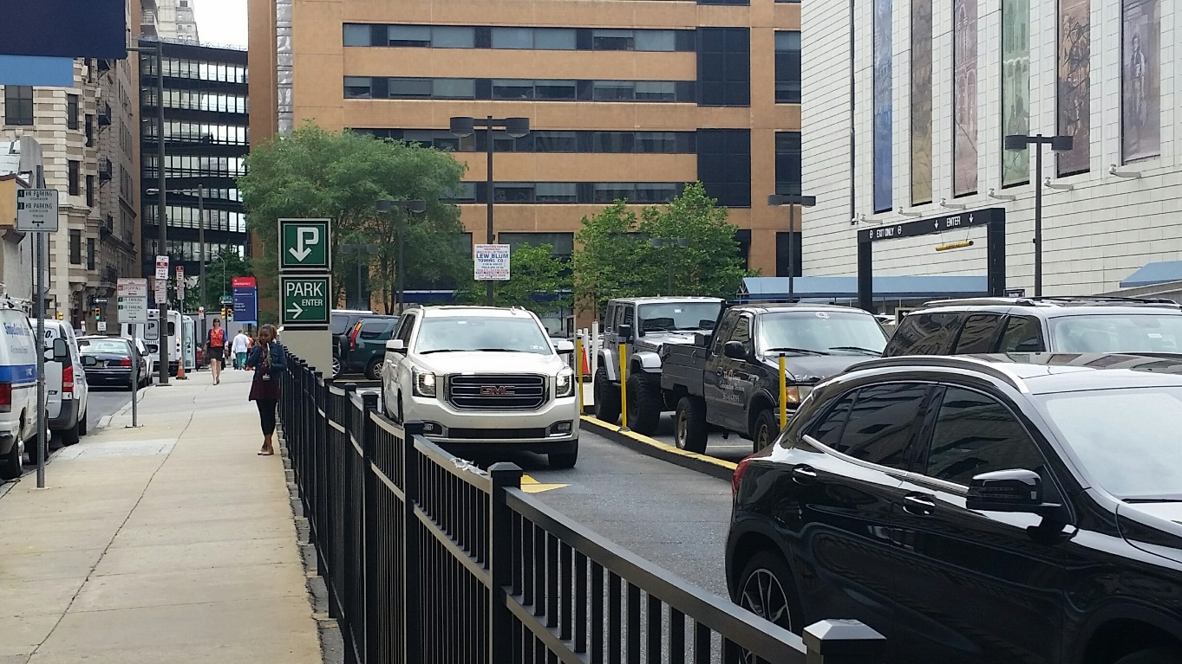
CONGESTION
Problem is spending in ordinate amount of time and resources (gas, CO2 emissions, Aggravation) in both;
Street parking Parking Lots

Slide 4
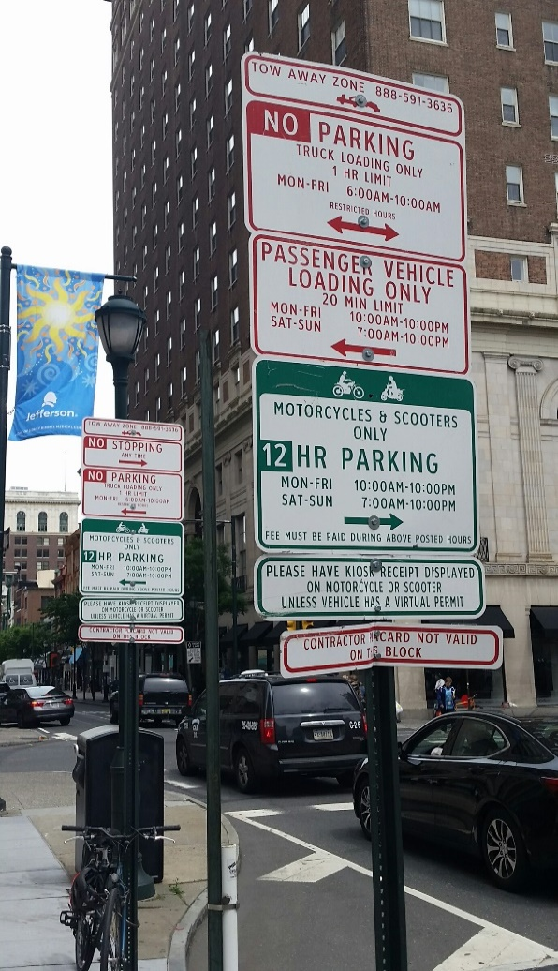
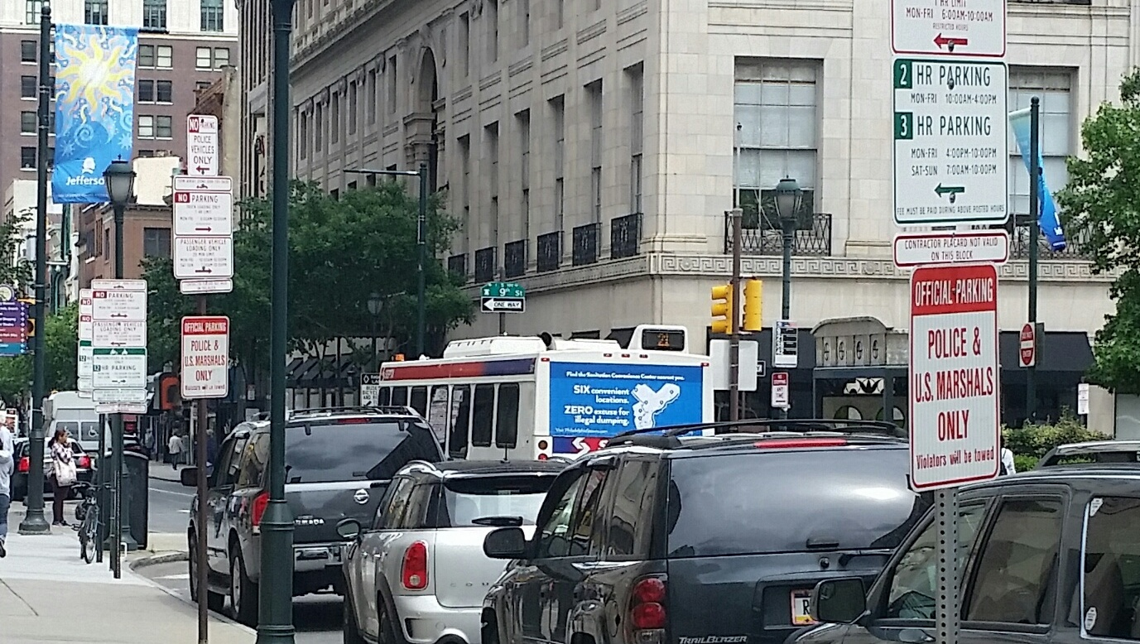
SAFETY
How can you keep an eye on the road when you are looking for a parking spot and at these rules;

Slide 5
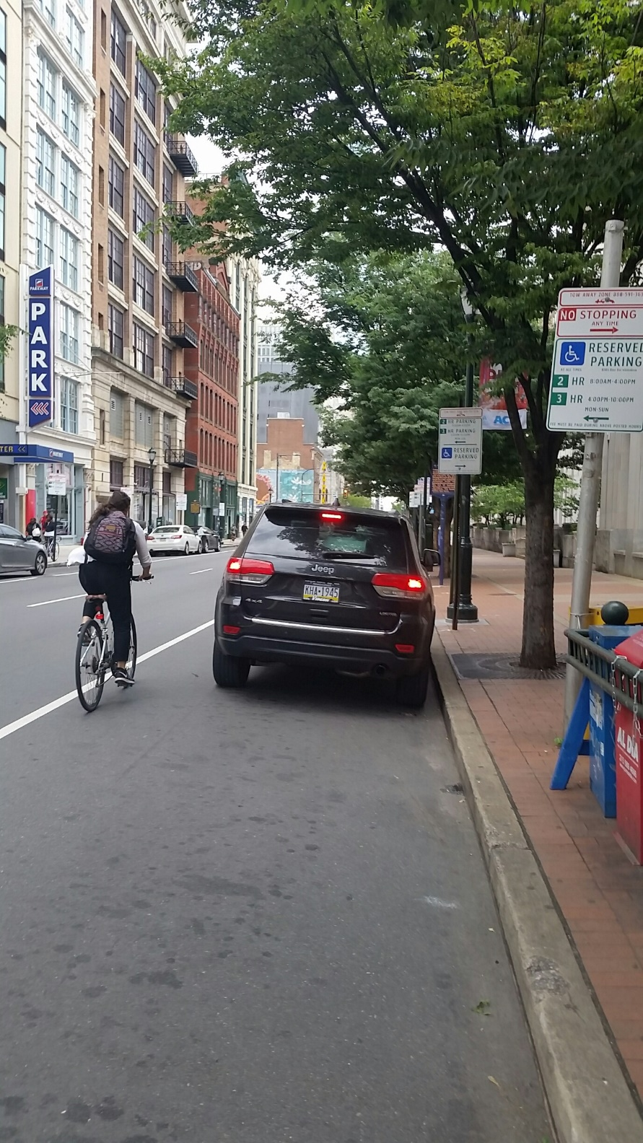
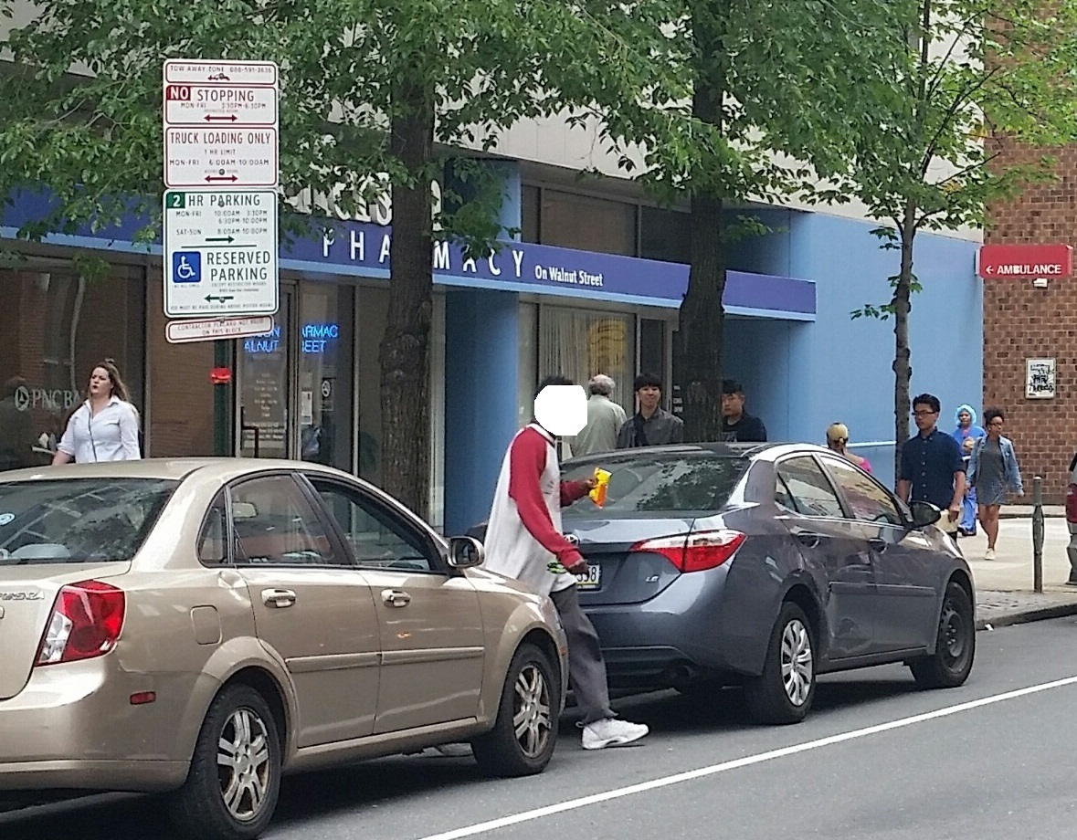
SAFETY
When you should be watching this.

Slide 6
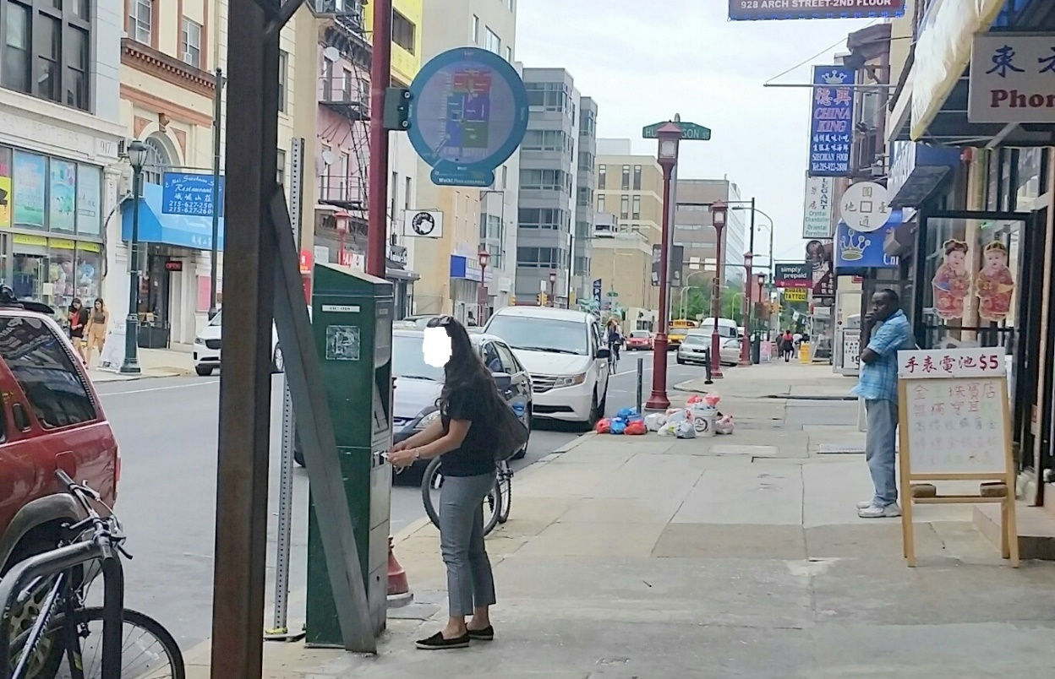
CONVIENIENCE
Why should you have to walk half a block, read instructions, walk back
another half block and make sure you place your ticket on the curbside
car dashboard?

Slide 7
ANALYTICS
Wouldn’t it be nice you could track;
Exactly where cars parked
How long it was in that spot
What is usage of that spot
And MORE

Slide 8
PROPOSAL
What if you could define the radius for you parking spot search (3 blocks with 1701 JFK Blvd)
What if you just had to hit a PAY button on your app when you find that spot?
What if you could exactly locate your car?
What if it generated a more reliable revenue stream and good ROI?

Slide 9
PROPOSAL
Generate a LoRa enable sensor that accurately monitors street parking and parking lots.
It’s small, low profile and durable for curb mounted for street parking or curb stop mounted.
Seamless process that ensures valid parking spot and generates a one button payment.
Makes compliance easier, generates violation notification and makes payment of violations more reliable.

